Slide 1
EMS A C++ based Employee Management System
By - Soham Sheth

Slide 2
Introduction to C++
Developed by Bjarne Stroustrup in 1983, C++ is a high-performance, general-purpose programming language.
Combines procedural and object-oriented programming.
Applications: Used in system software, games, embedded systems, operating systems, and browsers.
Key Features: Manual memory management, portability, and the Standard Template Library (STL).
Programs typically include libraries like <iostream> and use a main() function as the entry point.
Significance: Foundation for modern languages like Java and C#, widely used in competitive programming and system-level design.

Slide 3
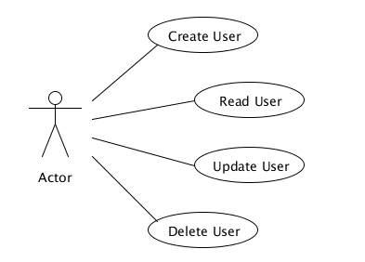
Overview
Key Points:
Console-based application for managing employee records.
CRUD operations with a secure login system.
Utilizes a doubly linked list for efficient data management.

Slide 4
OOP Principles In Use
Encapsulation: Employee details stored in Node class.
Abstraction: Users interact only with high-level methods.
Polymorphism: Constructor overloading in Node.
Modularity: Separate methods for each functionality.

Slide 5
Key Features
Uses the Single Responsibility Principle.
Readable and maintainable code.
Memory management with proper use of new and delete.
Error handling with user-friendly messages.

Slide 6
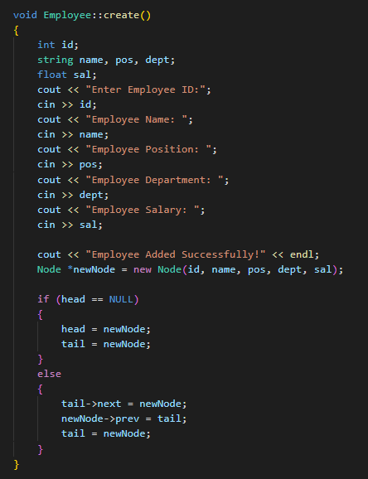
Outputs:

Slide 7
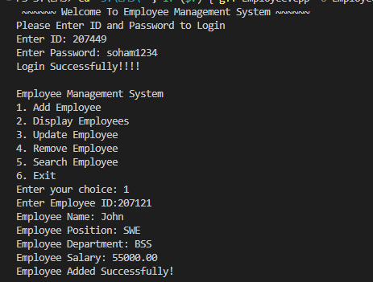
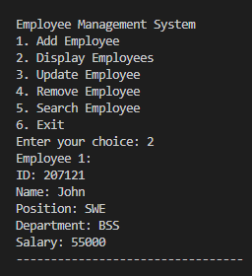
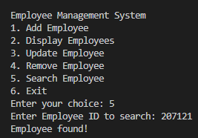

Slide 8
Thank You

